Slide 1
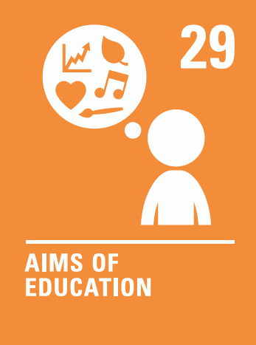
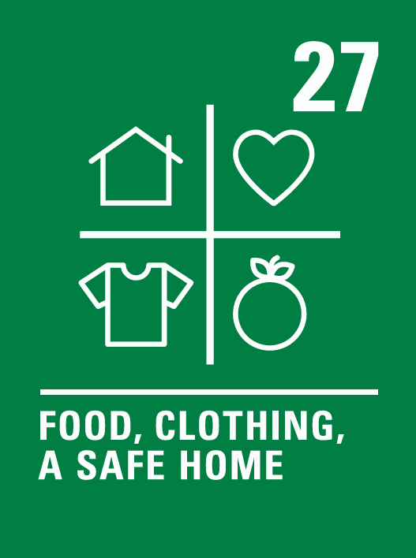

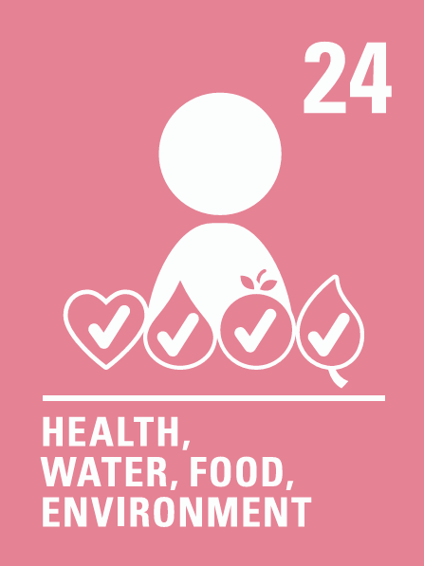


Coverage Spring 1 2025
Week | News Story | Focus Question | British Value Link | Protected Characteristics | UN Article
6th January | Birdwatch 2025 is an annual UK-wide citizen science project, held in January, in which people help gather data to support the work of scientists. | Is it our responsibility to protect local wildlife? | Rule of Law | Race
13th January | Prime Minister Keir Starmer has stated that building new homes is a 'top priority.' The government has announced changes to planning rules, aiming to make it easier to build homes in the countryside. | Should you be allowed to build homes anywhere? | Democracy | Age
20th January | The UK government’s culture secretary, Lisa Nandy, has written to video-sharing platforms, such as YouTube and TikTok, asking them to actively share more educational content for children. | Should YouTube have more rules for younger users? | Rule of Law | Age
27th January | New data has shown that 2024 was the Earth's hottest year on record, warming by 1.5°C. | Who should be involved in key decisions for the world? | Democracy | Race
3rd February | Tennis player Emma Raducanu has revealed that she would like to meet darts champion Luke Littler after stating her respect for his recent achievement in becoming a world darts champion. | Do you need to feel under pressure to achieve great things? | Individual Liberty | Age
10th February | The Nepalese government has announced that, from September, climbers aiming for the world’s highest mountain will have to pay just over £12,000 ($15,000) during the main climbing season | Should we be allowed to travel anywhere we like? | Mutual Respect & Tolerance | Religion or Belief
17th February | Global retail giant, Amazon, has announced its first UK drone deliveries will take place in Darlington as part of a trial. | Are drones the future of delivery? | Democracy | All
© Picture News 2025

