Slide 1







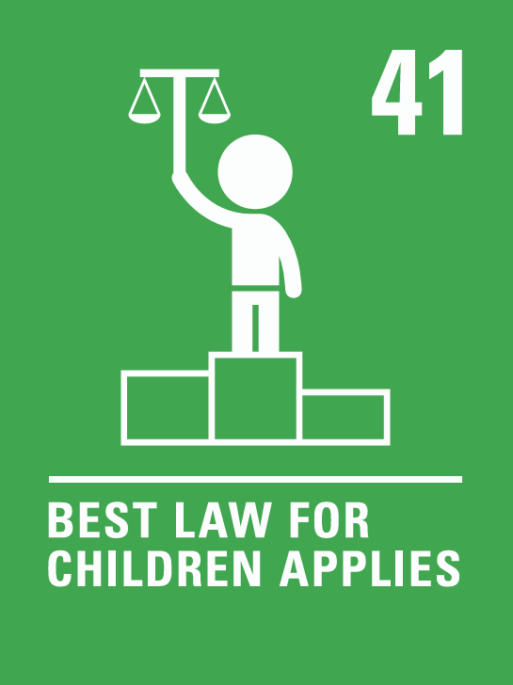

Coverage Autumn 1 2024
Week | News Story | Focus Question | British Value Link | Protected Characteristics | UN Article
26th August | A nine-year-old girl is set to make history as the youngest person ever to represent the UK internationally in any sport. Bodhana Sivanandan, from Harrow, northwest London, has been selected for the team representing England at the Chess Olympiad in Budapest in September. | Should your age ever stop you from doing something? | Democracy | Age
2nd September | Over the summer, many protests took place in England and Northern Ireland. Following the protests, communities in many towns, including Middlesborough, organised clean-up efforts that united people from all faiths and races. | How can communities help each other in times of difficulty? | Mutual Respect and Tolerance | Race
9th September | Space agency, Nasa, says two astronauts stuck on the International Space Station (ISS) won't return to Earth until next year. Sunita Williams and Barry 'Butch' Wilmore originally went on an eight-day mission but so far have remained for two months. | How can we respond to unexpected events? | Individual Liberty | Religion or Belief
16th September | The Wildlife Photographer of the Year shortlist has recently been announced, with just 100 photos left in the competition, following a record-breaking 59,228 entries! | How can photos shape the world? | Mutual Respect and Tolerance | Age
23rd September | The UK's first teacherless classroom, using AI (artificial intelligence) instead of human teachers has opened. David Game College, a school in London, opened its new course for twenty GCSE pupils in September. | Will classrooms of the future be teacherless? | Rule of Law | Religion or Belief
30th September | Book publishing company, Penguin Random House UK, has revealed a new book-vending machine at Linlithgow Academy, near Edinburgh, Scotland. The machine gives the pupils access to more than seventy different books from Penguin’s ‘Lit in Colour’ reading lists. | How important is it to know about the author behind the book? | Mutual Respect and Tolerance | Race
7th October | The company, Amazon, has told all staff they need to return to the office five days a week, ending the option to work from home. | How important are human interactions? | Individual Liberty | All
14th October | UK Prime Minister, Sir Keir Starmer, has faced questioning and criticism recently for accepting free gifts. | Why do people give gifts? | Rule of Law | Race
21st October | Following a ten-year campaign, music exam boards have announced they will now be including Sikh sacred music, also known as Kirtan, on their syllabus. | What impact can music have on our lives? | Democracy | Religion or Belief
© Picture News 2024

